Slide 1

Grace Guo, Yilin Qi, Victoria Tang

Slide 2
ML
Nutritional Science
+
Generating nutritious, personalized recipes that
best utilize user ingredients through a user-friendly web interface

Slide 3
01
Problem Statement
Target Audience
Notes:
We would like to first introduce our problem statement and target audience

Slide 4
44%
26.9%
22.2%
of Americans meal prep regularly
of Americans meal prep to save time
of Americans meal prep to eat healthier
MyProtein Americans Meal Prepping Habits 2022 Study
Notes:
Let’s first look at some statistics and needs of an average American who wants to learn how to cook

Slide 5
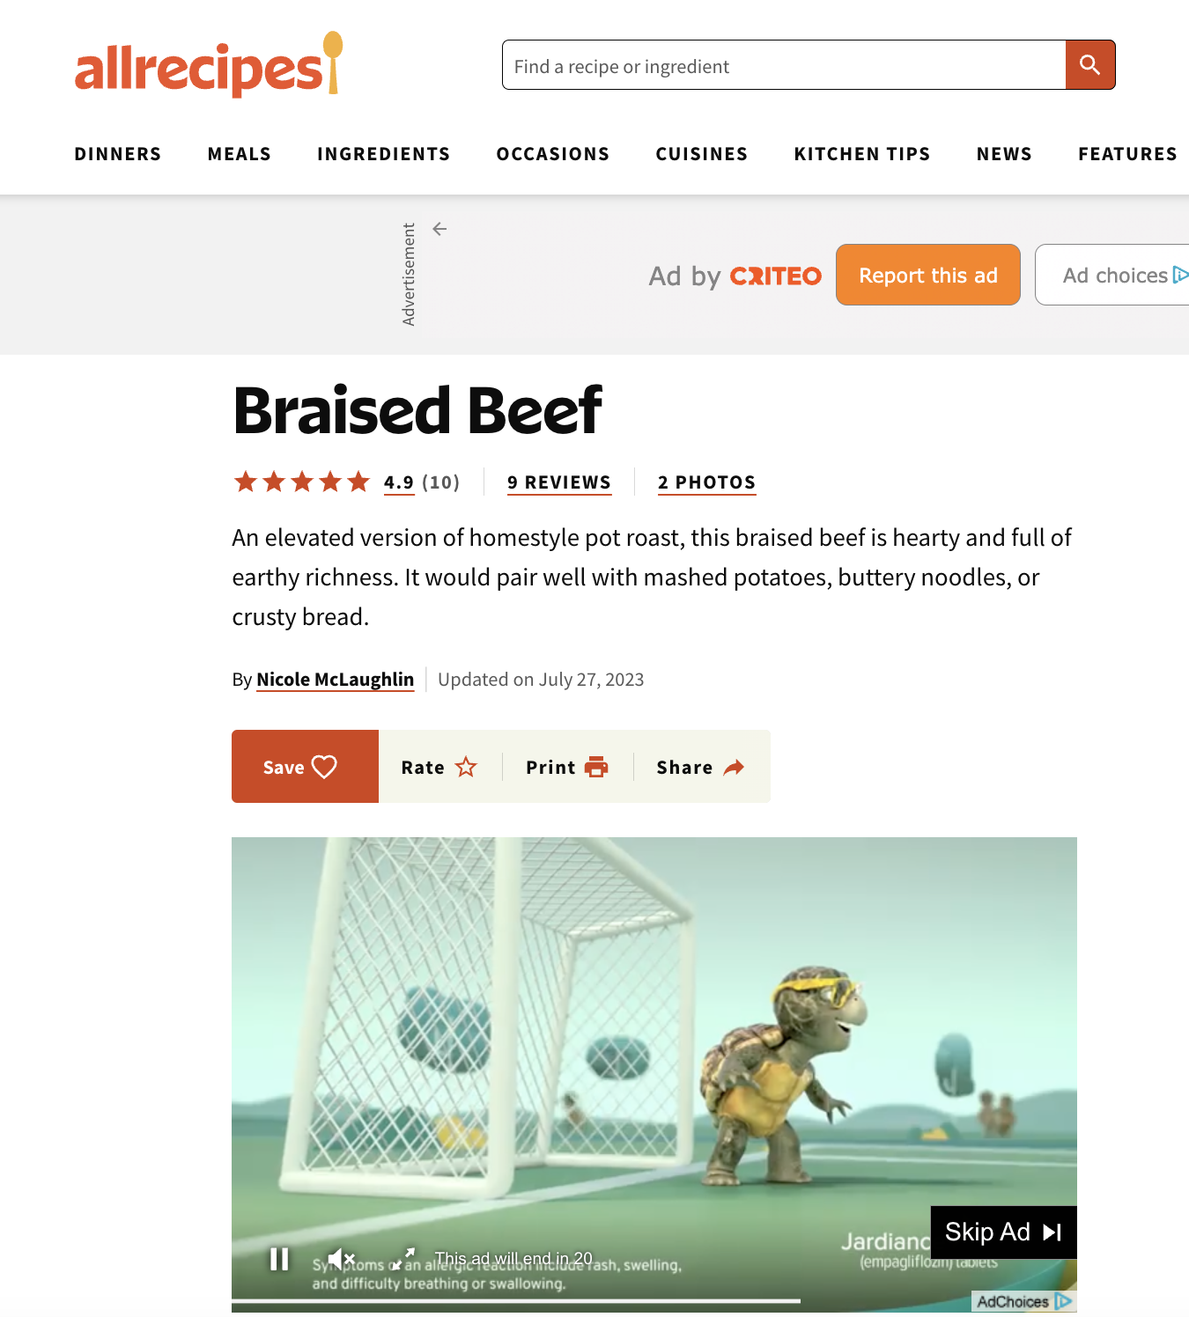
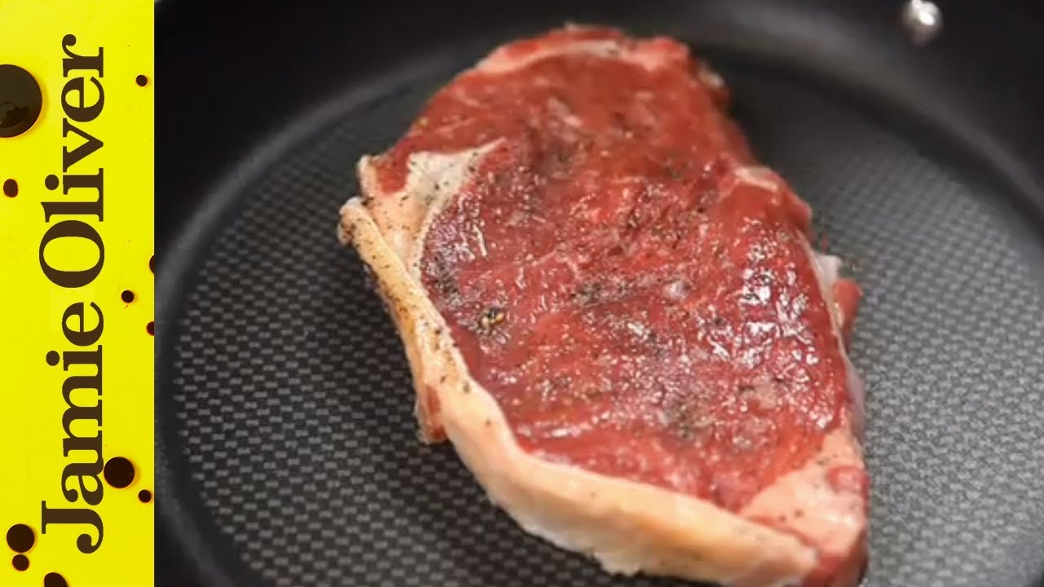

Current cooking resources overlook user needs
inconvenient, time consuming
Little to no nutritional information
Source
Notes:
These resources thus don’t address the 2 main motivations that we just discussed - saving time and eating healthy

Slide 6
$1300
an Average American spends
on food that end up being unused / discarded
William & Mary 2020 food waste study
Notes:
In addition, we find that

Slide 7
Problems that
addresses
Convenience
Nutrition
Waste
Our user can conveniently generate recipes with our user-friendly web app.
Recipes generated by ByteBites provide detailed nutritional facts to users.
ByteBites generates recipes that optimally utilize ingredients that the user has bought from their grocery store runs.
Notes:
We aim to address all 3 problems: Convenience, nutrition, and waste.
Our users can conveniently generate recipes with our user-friendly web app. The recipes generated will provide detailed nutritional facts and optimally utilize available ingredients that the user has brought to minimize waste.

Slide 8
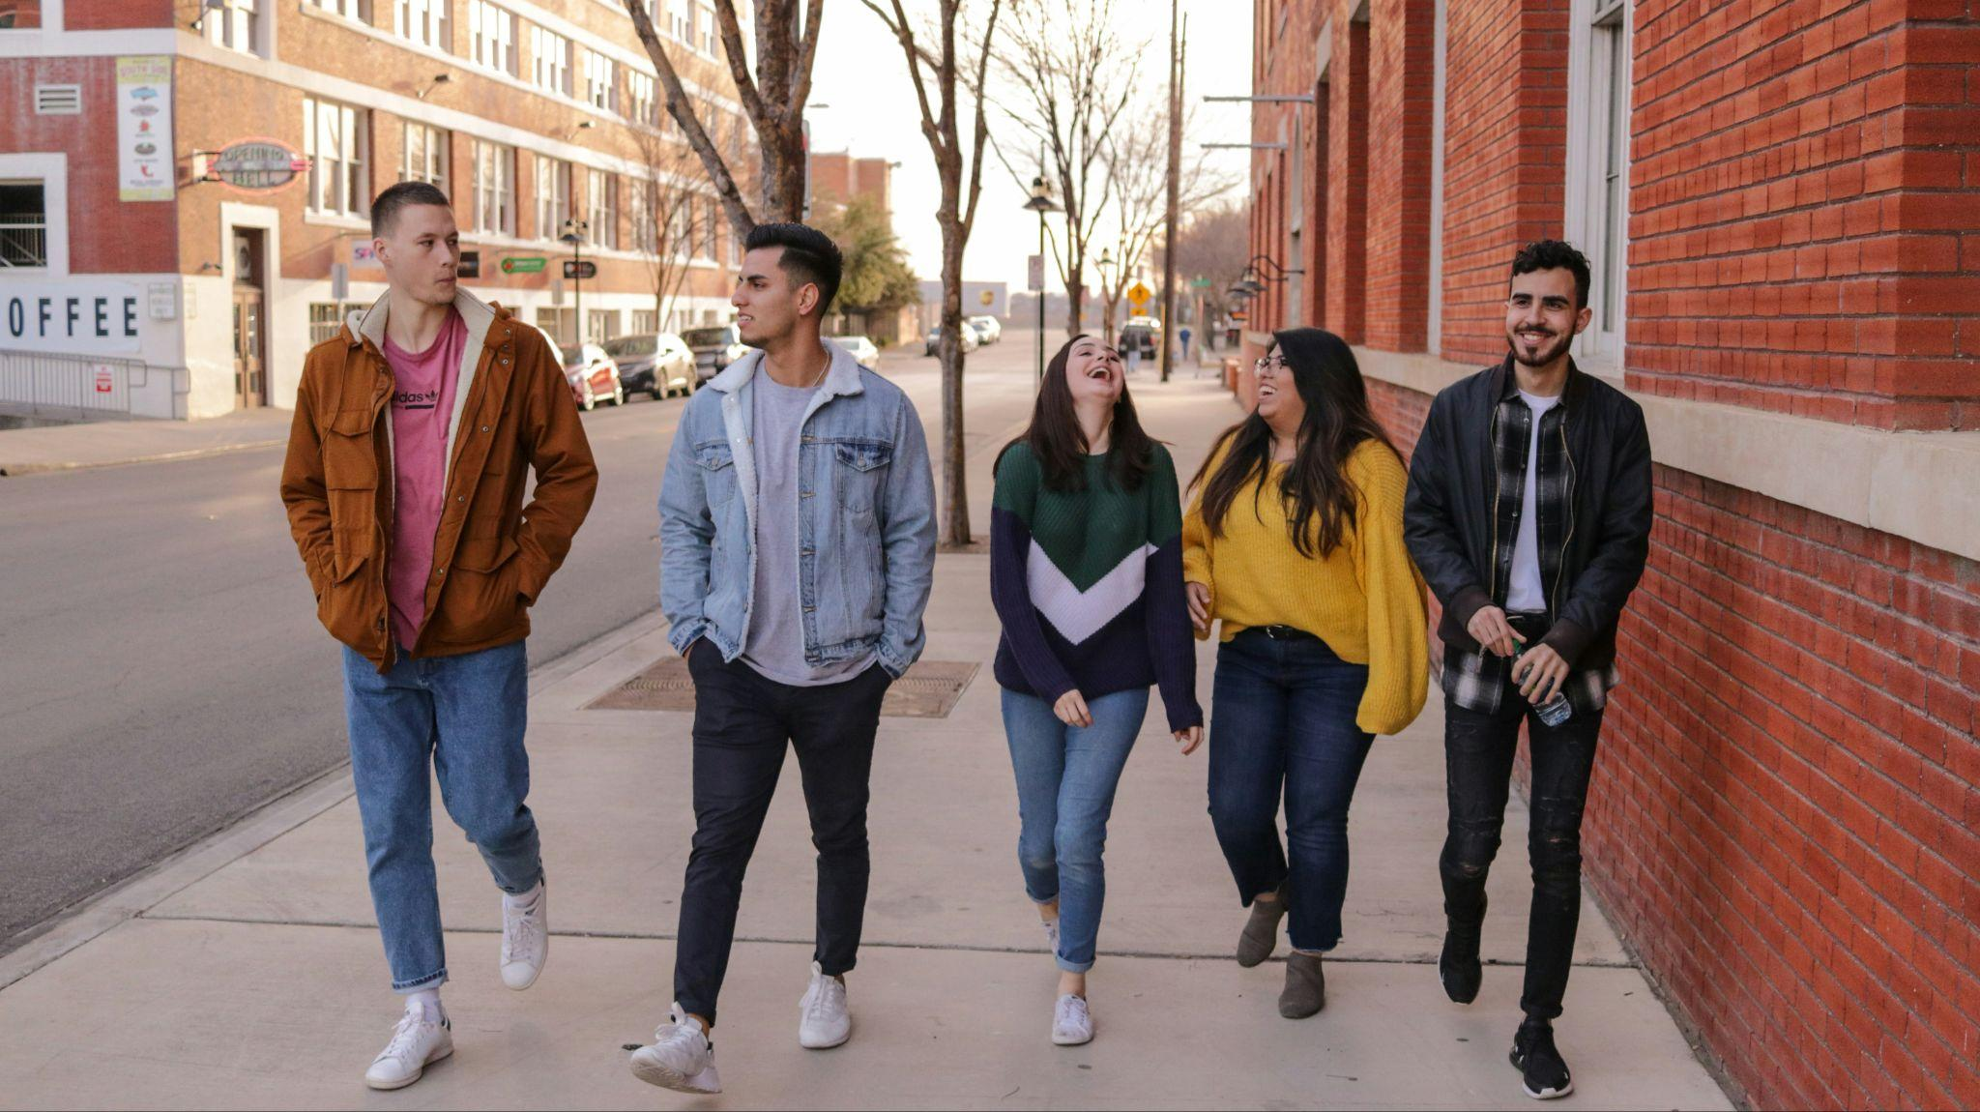

Target Audience
Looking for efficient, nutritious ways to prep meals
Looking to optimally utilize ingredients to save costs
High acceptance for AI-based applications
Early Career Individuals
College Students
Notes:
College students are generally new to cooking for themselves and have a high demand for recipes

Slide 9
02
Unique
Value Proposition
Notes:
explain what makes us unique in the recipe app market

Slide 10
Our Uniqueness
01
02
Automated Ingredient Recognition
Personalized
Meal Planning
Use OCR model to identify ingredients from receipt
Dietary restrictions, time constraints & meal types
03
04
Health and Wellness integration
User-Driven Recipe Refinement
Monitor nutrients intake and provide insights on user’s diet
Incorporate user ratings with RLHF to improve recipe recommendation
Notes:
Our uniqueness lies in four key features:

Slide 11
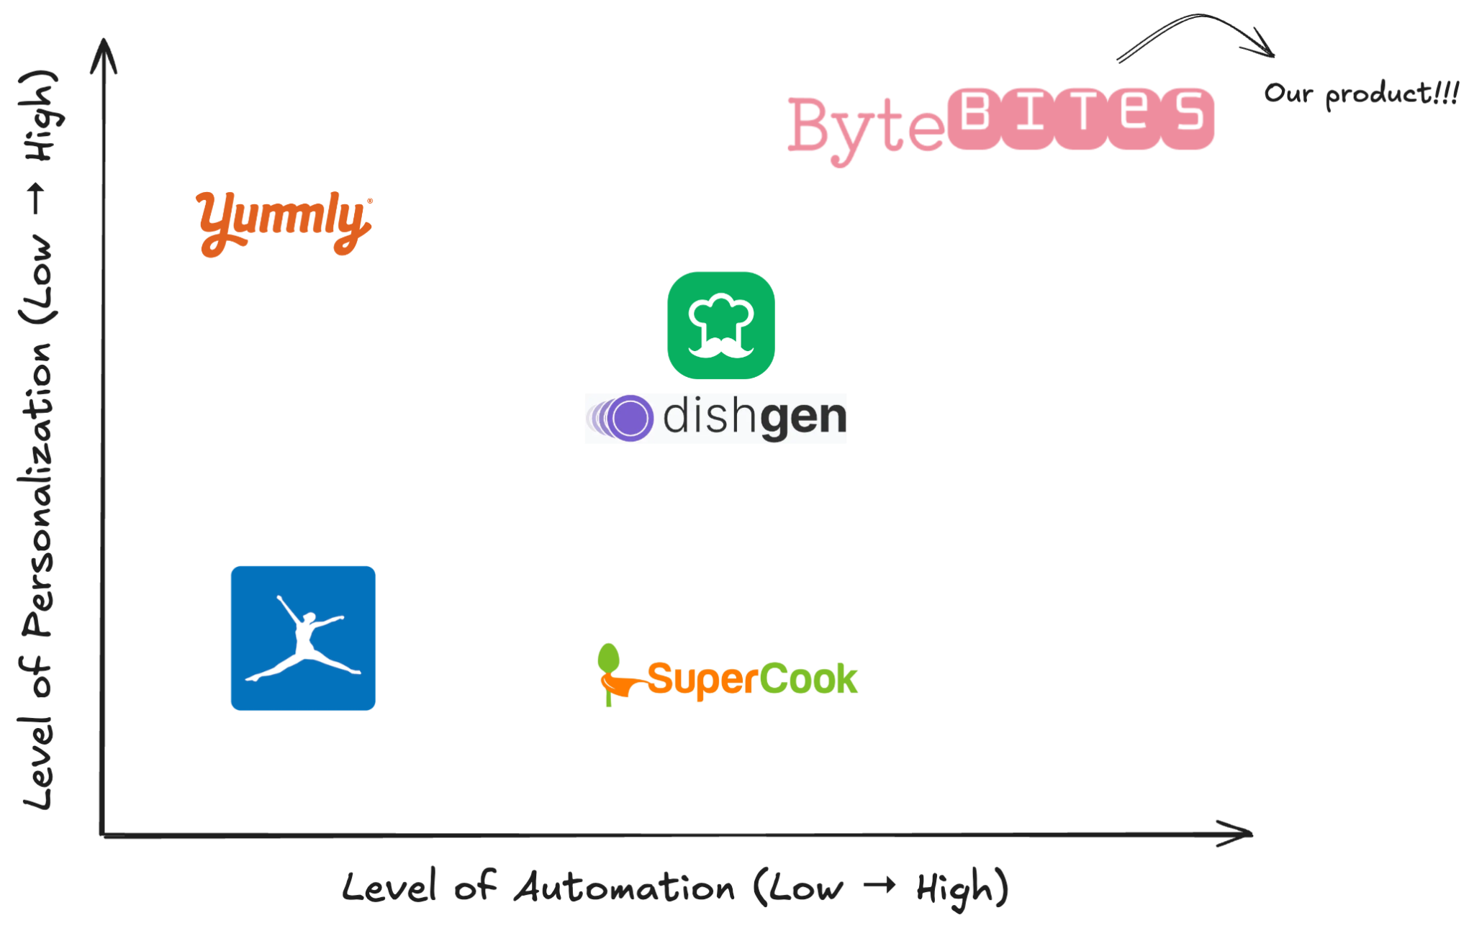
Competitive Position
Notes:
In the recipe app market, we've positioned ourselves to offer a unique blend of high automation and personalization level.
These three AI recipe app all require users to manually input ingredients and offer little personalized choices.
These two competitors don’t have any ML integration.

Slide 12
03
Bytebites Demo
Notes:
3. Scalability and Efficiency
Technical Scalability: Discuss how your application can scale to meet growing demands.
Performance Optimization: Explain any optimizations implemented for efficiency (e.g., fine-tuning, infrastructure choices).
Infrastructure Considerations: Briefly mention the technologies used (e.g., GCP, Docker, Vertex AI) and why they were chosen.

Slide 13
04
Scalability and Efficiency
Notes:
Dive into the Architecture & technology to support

Slide 14
Model & Optimization
We use recipe data from food.com containing 180K recipes and 700K reviews, reflecting 18 years of user interactions and uploads.
We finetune facebook-opt-125m model on the recipe dataset and we plan to use the Llama3-8B model in our final application.
Task specific
Efficient Training
Tailored for user
Data
Model
Fine-tuning
PEFT
(LoRA)
RLHF
Notes:
We choose fine-tuning over RAG for optimized performance.

Slide 15



Infrastructure Considerations
Notes:
We package each components into Docker containers, use GCP to support various aspects, from data storage to running ML algorithms. We use Vertex AI for for building, deploying and managing our ML models and.
Allows automatic scaling to accommodate increased numbers of users and computing needs in the future.
We package applications and their dependencies into containers, ensuring consistent environments across development, testing, and production.
We use GCP to support various aspects of our application, from data storage to running ML algorithms. GCP ensures high availability and low latency for our use cases.
We use Vertex AI for for building, deploying and managing our ML models. Vertex AI helps us handle large datasets and complex model training efficiently, as well as offering pipelines to efficiently manage our ML workflow.

Slide 16
05
Future Development
& Growth Potential

Slide 17
Future Development Roadmap
Integration
Community
Seamless interaction between the app and smart kitchen appliances
Foster a community of cooking enthusiasts and encourage social interaction.
Notes:
plans for further development:
Integration: include seamless interaction between the app ad smart kitchen appliances
Plan to foster a community of cooking enthusiasts and encourage social interaction

Slide 18
Expanding Globally Through Localization
Objective: To attract international users by tailoring the app's content to various languages and regional culinary preferences.
Islam
7%
Halal food: no alcohol, cblood, pork
0.2%
16 million
Buddhism
24%
Vegetarianism
Judaism
Kosher food: no port and shellfish
Notes:
Global Market Penetration:
Localize the app in multiple languages and adapt the content to regional culinary preferences to attract international users.

Slide 19

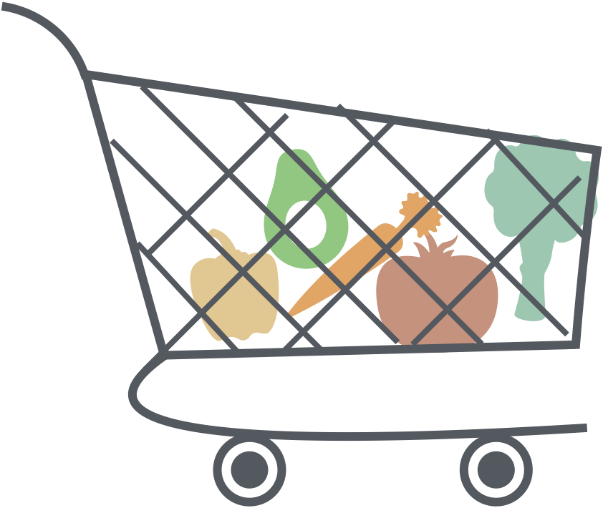

Retail Partnership
Objective: Integrate with grocery retailers to enable direct ordering from the app, making shopping seamless and convenient.
Shopping List
Monday: California Sushi Roll
Ingredient:
- Seaweed Nori
- Avocado
- …
Tuesday: Tacco
Notes:
Retail Partnerships:
Partner with grocery retailers for generate shopping lists and direct grocery ordering within the app, enhancing user convenience.
Objective: Integrate with grocery retailers to enable direct ordering from the app, making shopping seamless and convenient.
Key Benefits: User Convenience: Simplify the shopping process with automated list creation and one-click ordering.
Personalization: Tailor shopping lists based on user preferences and dietary restrictions.
Time-Saving: Reduce the time users spend on planning and purchasing grocery items.
Implementation Steps
Identify Partners: Collaborate with leading grocery chains that have robust online delivery systems.
Technology Integration: Develop APIs to connect the app’s database with retailer inventory systems.
User Interface Design: Create an intuitive interface for easy addition of ingredients to shopping carts.
Expected Outcomes
Increased App Usage: Drive more frequent app usage as users rely on it for both cooking and shopping.
Enhanced Customer Loyalty: Improve user retention through added convenience and personalized shopping experiences.

Slide 20

THANKS
DO YOU HAVE ANY QUESTIONS?
ruyi_guo@g.harvard.edu
yilinqi@g.harvard.edu
xutang@g.harvard.edu
Please keep this slide for attribution

